Slide 1

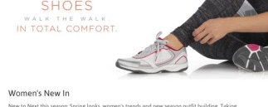

SHOPPING CART
WEB APP
WFE FRESHER
PRESENTATION
Mentor : Tang Chau Viet Hai

Slide 2

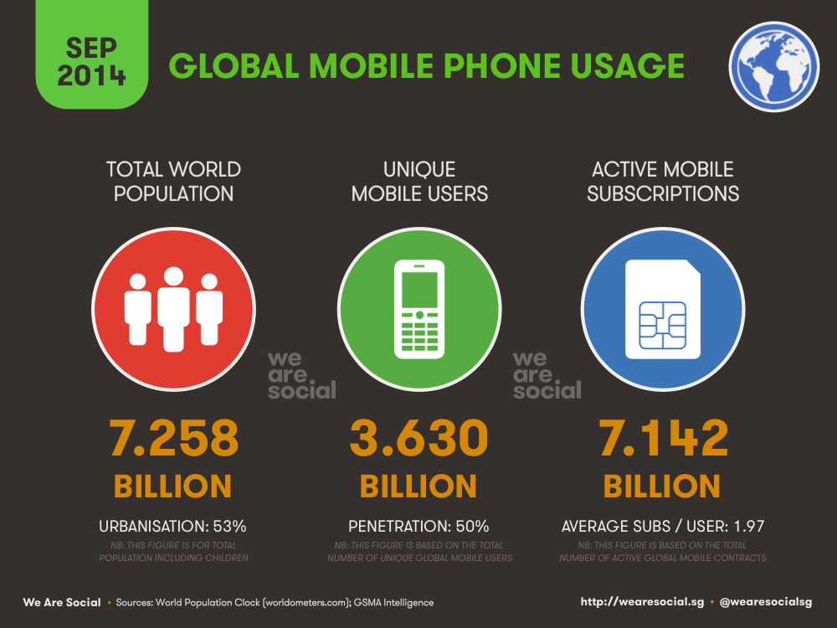
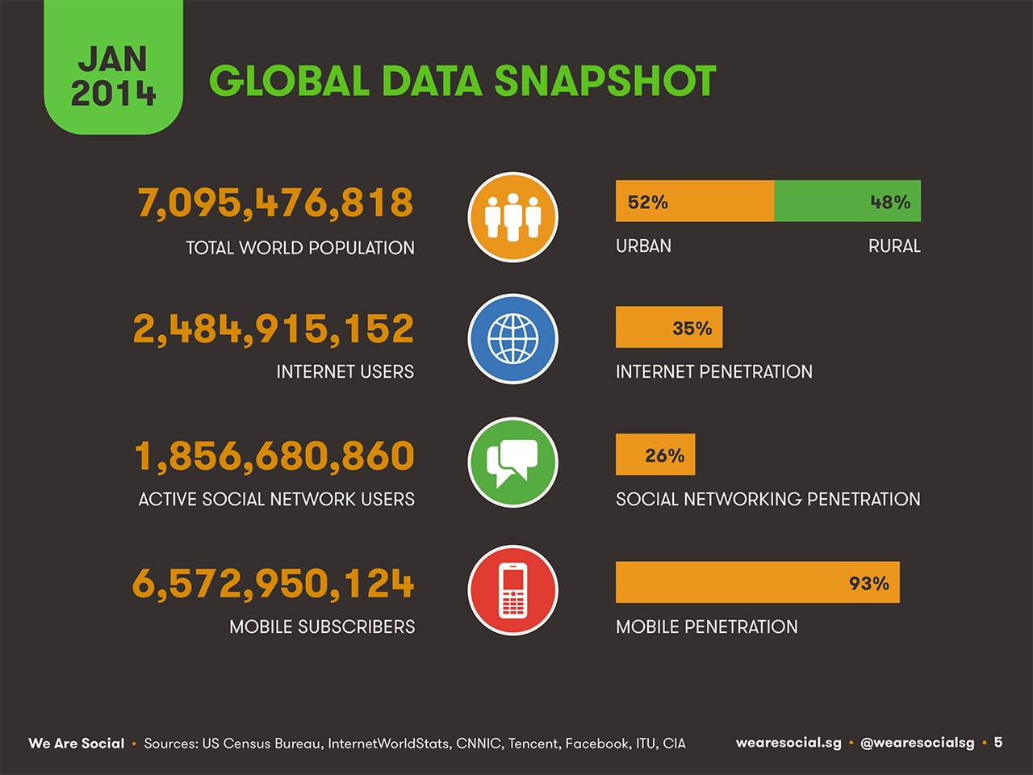
Introduction
+
=
|
\
Backspace
PrtSc
SysRq
Home
}
]
Delete
End
“
‘
Shopping
Page
Up
Page
Down
Shift
Insert
Alt
Ctrl

Slide 3
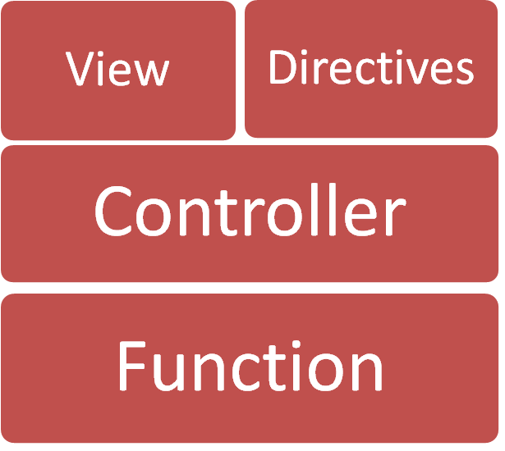


Appication Structure
Notes:
Gulp to buid system
Sass for style

Slide 4





Appication Structure

Slide 5



Appication Structure
Notes:
Jasmine test farmeworks
Karma test runners
Excute in browsers

Slide 6
DEMO

Slide 7
Q & A

Slide 8
Thank You

